Slide 1
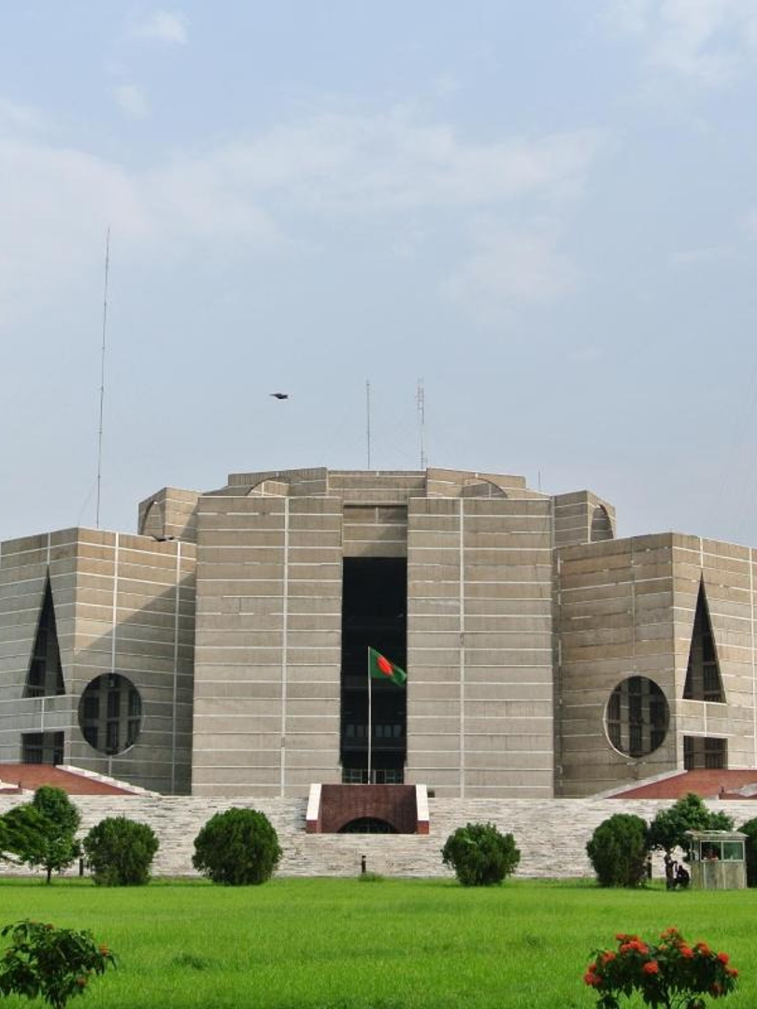

FORMAL PROPOSAL BRIEFING · OCTOBER 2026
National University
Public Service
Semester Programme
A Formal Proposal to the Government of Bangladesh — embedding one supervised, credit-bearing semester of public service in every undergraduate degree
Prepared by Gulshan Sync Solution · Sylhet, Bangladesh
Sultan Bayezid, Managing Director · bayezid@gulshansync.com
Grounded in a four-phase research programme: 123 registered sources · 36 datasets · 35 documented data gaps · every figure traceable
National Parliament House, Dhaka
Notes:
- Open by naming the proposal: one supervised, credit-bearing public-service semester embedded in every undergraduate degree in Bangladesh.
- Ground the briefing in evidence: four research phases, 123 registered sources, 36 datasets, 35 documented data gaps — every figure traceable.
- Introduce the preparer: Gulshan Sync Solution, Sylhet; contact Sultan Bayezid, Managing Director.
- Preview the arc of the briefing: the case for action, the proposal design, what students do and never do, financing, and phased implementation.

Slide 2
EXECUTIVE SUMMARY
The proposal in one sentence
Embed one supervised, credit-bearing public-service semester in every undergraduate degree — financed by universities within existing fee structures, and phased to a verified ceiling of roughly 130,000 participants per year.
130,178
5
4
7,567–16,033
75.7–160.3
·
BDT
BDT
crore
phases
gates
Baseline-feasible participants per year — the direct-university final-year pool (52,651 public + 77,527 private)
University cash cost per participant (low–high band, 8 cost lines)
Annual cost at 100,000 participants — 0.28–0.59% of the Tk 10,802 crore public university system budget
Independent evaluation published before every expansion; scale never outruns the supervisor pipeline
No new government appropriation
No new compulsory student fee
No claimed corruption savings — integrity outcomes are measured, never promised
Notes:
- Frame the whole proposal in one sentence: a credit-bearing service semester inside every degree, university-financed, phased to roughly 130,000 participants per year.
- 130,178 is the verified direct-university final-year pool: 52,651 public + 77,527 private.
- Cost band is BDT 7,567–16,033 per participant; at 100,000 participants that is 75.7–160.3 crore — only 0.28–0.59% of the Tk 10,802 crore public university system budget.
- Stress the three rules: no new government appropriation, no new compulsory student fee, and zero claimed corruption savings.
- Five phases with four gates: independent evaluation is published before every expansion, and scale never outruns the supervisor pipeline.

Slide 3
THE CASE FOR ACTION
Public delivery is capacity-constrained
521,922
vacant posts
🏛
= 26.3% of the 1,986,272 sanctioned posts in government service (filled: 1,464,350; as of 30 June 2025, Statistics of Government Employees)
CONSTITUTIONAL ANCHOR
Recruitment cannot catch up
Constitution, Article 21 — the duty of every citizen to observe the Constitution and laws, maintain discipline, perform public duties and protect public property.
BCS recommendations run only 1,457–2,805 per cycle (43rd–47th BCS, 2023–26) while roughly 40,000 employees retire each year (World Bank estimate).
Four structural frictions
§
Citizen charters diverge from practice — waits, steps and informal demands
Delays create speed-money opportunities at bottlenecks
Incomplete paper registers leave space for ghost entries
Information asymmetry forces citizens to rely on brokers
The binding gap is not only budget — it is delivery capacity, records discipline, and citizen information.
Notes:
- Lead with the scale of the vacuum: 521,922 vacant posts — 26.3% of the 1,986,272 sanctioned posts, with 1,464,350 filled as of 30 June 2025.
- Recruitment arithmetic cannot close it: 1,457–2,805 BCS recommendations per cycle (43rd–47th BCS, 2023–26) against roughly 40,000 retirements a year.
- Walk the four frictions: charters vs practice, delay-driven speed money, ghost entries in paper registers, and broker dependence from information asymmetry.
- Article 21 anchors the idea constitutionally — public duty is already a citizen's obligation; the programme gives it structured expression.
- Land the closing point: the binding gap is delivery capacity, records discipline, and citizen information — not only budget.

Slide 4

THE UNDERUSED RESOURCE
A trained cohort the size of a city — untouched by public service
4,690,876
344,528
tertiary students enrolled (2020, all sectors — UGC Annual Report)
university graduates per year (2021 — the only verified national graduate figure)
Curzon Hall, University of Dhaka
173
130,178
ⓘ
SCOPE NOTE
The National University system — around 2,500 affiliated colleges and roughly 4 million students — sits outside the baseline scope; it enters only as a later, voluntary extension.
universities (63 public · 108 private · 2 international)
direct-university final-year students — the immediately eligible pool
Every year Bangladesh graduates hundreds of thousands of disciplined, literate, discipline-trained citizens — none of whom currently touch a government office before entering the job market.
Notes:
- The cohort is city-sized: 4,690,876 tertiary students enrolled in 2020 across all sectors (UGC Annual Report).
- 344,528 university graduates per year (2021) — the only verified national graduate figure — across 173 universities (63 public, 108 private, 2 international).
- The immediately eligible pool is 130,178 direct-university final-year students.
- Clarify scope: the National University system (~2,500 colleges, ~4 million students) is outside the baseline and enters only later, voluntarily.
- Punchline: graduates never touch a government office before entering the job market — an unused national asset.

Slide 5
THE PROPOSAL
One semester of service, inside the degree
A compulsory, credit-bearing, supervised public-service semester — a graduation requirement, financed by universities within existing fee structures.
01
In-degree, not appended
02
Discipline-matched
03
Supervised
substitutes existing internship/attachment credits; graduation-delay neutral, protecting against session jam.
placements follow field of study across 14 verified host sectors.
one trained supervisor per 20 students; host-office focal point for every placement.
04
Bounded role
05
University-funded
06
Transparent by design
students support and document; they never exercise statutory power.
within existing fee structures; no new appropriation, no new fee.
digital attendance, task logs, and published aggregate statistics.
Notes:
- State the core commitment plainly: compulsory, credit-bearing, supervised — a graduation requirement financed by universities within existing fee structures.
- In-degree, not appended: the semester substitutes existing internship/attachment credits, so it is graduation-delay neutral and protects against session jam.
- Placements are discipline-matched across 14 verified host sectors, with one trained supervisor per 20 students plus a host-office focal point.
- Roles are bounded: students support and document, never exercising statutory power.
- Close on transparency: digital attendance, task logs, and published aggregate statistics by design.

Slide 6
WHAT STUDENTS DO
Discipline-matched assignments across 14 verified host sectors
▢
CSE / IT
⚖
Law
✦
Statistics
Records digitization on approved project lists · portal content · data-entry quality assurance
Legal-aid clinic reception and form assistance · RTI awareness sessions · supervised research
BBS-authorized survey enumeration · aggregate data-quality checks
Digital government (ICT Division, a2i)
Public information & justice-adjacent
Research, statistics & data quality
✚
Medicine & Public Health
🏛
Business & Accounting
▿
Education
Immunization campaign recording · clinic queue management · health-education sessions
Bid document organization (never evaluation) · asset-register digitization
After-school tutoring · attendance register digitization · library organization
Healthcare (418 upazila health complexes)
Procurement documentation cells (CPTU SOP)
Education (65,567 primary schools)
Host network already verified: 495 upazila complexes · 4,554+ union parishads · 330 pourashavas · 2,260–2,500 NU colleges · 27 discipline clusters mapped in the research database
Notes:
- Six examples of discipline-matched assignments across the 14 verified host sectors; 27 discipline clusters are mapped in the research database.
- CSE/IT supports digital government (ICT Division, a2i): records digitization, portal content, data-entry QA. Law supports legal-aid reception, RTI awareness, supervised research.
- Statistics students do BBS-authorized survey enumeration and aggregate data-quality checks; Medicine supports 418 upazila health complexes.
- Note the embedded guardrail: business students organize bid documents but never evaluate them (CPTU SOP).
- The host network is already verified: 495 upazila complexes, 4,554+ union parishads, 330 pourashavas, 2,260–2,500 NU colleges.

Slide 7
WHAT STUDENTS NEVER DO
Hard role limits — the guardrails are the design
NO
No statutory or inspection powers
⛨
IF A STUDENT INCIDENTALLY OBSERVES MISCONDUCT
Students hold no ACC powers, no enforcement role, no authority over any citizen or officer.
NO
No confidential or personal records
Aggregate and de-identified tasks only, under a data-access MOU per placement.
01
Confidential referral form
NO
No procurement evaluation
02
Program protection officer
Documentation organization only; bid security and evaluation materials are off-limits.
03
Department head, ACC public complaint channel, or PIDA 2011 whistleblower protection
NO
No confrontation of staff
Findings flow through supervisors and the program M&E unit, never public accusation.
NO
No replacement of government employees
Support role only; the 521,922 vacant posts are unfilled jobs, not hosting capacity.
Students are never tasked to find misconduct.
The integrity contribution comes from structured presence and documentation — not from investigative powers.
Notes:
- Walk the five hard limits in order: no statutory or inspection powers, no confidential or personal records, no procurement evaluation, no confrontation of staff, no replacement of government employees.
- Stress that the 521,922 vacant posts are unfilled jobs, not hosting capacity — students never fill posts.
- Explain the incidental-misconduct pathway: confidential referral form, then program protection officer, then department head, ACC public complaint channel, or PIDA 2011 whistleblower protection.
- Close on the framing line: integrity comes from structured presence and documentation, never from investigative powers.

Slide 8
PARTICIPATION SCENARIOS & POOL GAP
The participation math — and the 300,000 problem
100,000
KEY FINDING
/ YEAR
8.5% of the national final-year cohort — entry scale, baseline-feasible
300,000 exceeds the direct-university final-year pool by
169,822
200,000
Direct pool = 130,178 (52,651 public direct + 77,527 private, derived from verified enrollment bases).
/ YEAR
Requires National University college participation
300,000
/ YEAR
Any 300,000 program structurally requires National University affiliated-college participation — which the university-funded baseline cannot carry.
25.6% of the national final-year cohort, 6.4% of total enrollment
RECOMMENDATION
Phase to the ~130,000/year ceiling under the baseline; NU colleges enter later, voluntarily, under a separate financed model.
DATA INTEGRITY · Mixed data vintage (2015 public-direct / 2021 private enrollment bases); treated as an order-of-magnitude estimate — refinable through the registered RTI pathway.
Notes:
- Anchor on the three scenarios: 100,000/year is the entry scale (8.5% of the national final-year cohort, baseline-feasible); 200,000 requires NU college participation; 300,000 equals 25.6% of the cohort and 6.4% of total enrollment.
- Deliver the key finding slowly: 300,000 exceeds the direct-university final-year pool by 169,822.
- Explain the pool arithmetic: direct pool = 130,178 (52,651 public direct + 77,527 private), derived from verified enrollment bases.
- Therefore any 300,000 program structurally requires NU affiliated colleges — which the university-funded baseline cannot carry.
- Recommendation: phase to the ~130,000/year ceiling; NU colleges enter later, voluntarily, under a separate financed model. Note the mixed data vintage caveat if asked.

Slide 9
FINANCING THE BASELINE
Universities pay — within the fees students already pay
FUNDING RULES
No new government appropriation
No new compulsory student fee
Students pay exactly what they pay today
COST STACK · BDT PER PARTICIPANT
low / medium / high
NO STIPEND
COST LINE | LOW | MEDIUM | HIGH
University coordination & administration | 1,000 | 1,500 | 2,000
Orientation & role training | 2,000 | 3,500 | 5,000
Accident & medical insurance | 500 | 500 | 500
Placement platform (amortized) | 1,667 | 2,500 | 3,333
Records & certification | 200 | 350 | 500
M&E + independent audit | 300 | 500 | 800
Accessibility accommodations | 100 | 200 | 300
Need-based support fund (30% of participants) | 1,800 | 3,000 | 3,600
TOTAL | 7,567 | 12,050 | 16,033
No statutory wage obligation identified for degree-required placements; domestic precedents are unpaid (DU BBA internship, B.Ed. practice teaching, Indonesia KKN) — a need-based fund covers ~30% of participants instead.
SCENARIO TOTALS
100,000 = BDT 75.7–160.3 crore/yr
200,000 = 151.3–320.7 crore/yr
300,000 = 227.0–481.0 crore/yr
(not baseline-feasible)
PUBLIC SHARE AT 100K
BDT 30.3–64.1 crore = 0.28–0.59% of the Tk 10,802 crore public university system budget.
One-time national setup: BDT 20–50 crore.
Notes:
- Lead with the funding rule: universities pay within existing fee structures — no new government appropriation, no new compulsory student fee, students pay exactly what they pay today.
- Walk the eight cost lines; the total is BDT 7,567 / 12,050 / 16,033 per participant (low / medium / high).
- No stipend: no statutory wage obligation for degree-required placements; domestic precedents (DU BBA internship, B.Ed. practice teaching, Indonesia KKN) are unpaid — a need-based fund covers ~30% of participants instead.
- Scenario totals: 100,000 participants = BDT 75.7–160.3 crore/yr; 200,000 = 151.3–320.7; 300,000 = 227.0–481.0 (not baseline-feasible).
- Public share at 100k: BDT 30.3–64.1 crore = 0.28–0.59% of the Tk 10,802 crore system budget; one-time national setup BDT 20–50 crore.

Slide 10
AFFORDABILITY BY SEGMENT
Who can carry it — segment by segment
Feasible
Conditional / stressed
Not feasible
SEGMENT | STEADY-STATE PARTICIPANTS | COST SHARE | VERDICT
Public direct universities49–53 teaching | 40,000 | 0.28–0.59% of system budget | CONDITIONALLY FEASIBLE Requires a UGC budget-line circular (spending authority, not new money)
Private top tier~20 institutions | 25,000 | 1.6% of est. revenue | FEASIBLE Absorbable within operating margins
Private mid tier~50 | 30,000 | 3.4% | STRESSED Phased entry criteria recommended
Private lower tier~46 | 13,500 | 8.2% | NOT FEASIBLE Exclusion or deferral
NU affiliated colleges~2,500 | 169,822 needed | 64.3% of NU’s entire UGC transfer | STRUCTURALLY INFEASIBLE Under the baseline — voluntary opt-in later
Open Universitydistance | excluded | — | Distance learners geographically dispersed
Private sector context: 53% seat occupancy sector-wide and a 17-year-low 2025 HSC pass cohort — affordability screens are load-bearing, not decorative.
Notes:
- Read the table by verdict color: green = feasible, amber = conditional or stressed, red = not feasible.
- Public direct universities: 40,000 steady-state participants at 0.28–0.59% of the system budget — conditional on a UGC budget-line circular (spending authority, not new money).
- Private tiers: top tier (~20 institutions) feasible at 1.6% of estimated revenue; mid tier (~50) stressed at 3.4%, phased entry criteria recommended; lower tier (~46) not feasible at 8.2% — exclusion or deferral.
- NU affiliated colleges: 169,822 participants needed = 64.3% of NU's entire UGC transfer — structurally infeasible under the baseline; voluntary opt-in later. Open University excluded (distance learners dispersed).
- Context: 53% private seat occupancy sector-wide and a 17-year-low 2025 HSC pass cohort — the affordability screens are load-bearing, not decorative.

Slide 11
INTEGRITY ARCHITECTURE
Integrity by structure — measured, never promised
9
ANTI-CORRUPTION MECHANISMS
6
SAFEGUARDS
01
Service-delivery monitoring against published citizen charters (pre-approved instruments)
01
Retaliation protection — PIDA 2011 coverage + protection officer
02
Delay & bottleneck documentation from official registers
03
Completeness of non-sensitive public records
02
Privacy — data MOUs, no personal files
04
Authorized digitization projects (scoped credentials)
03
Political neutrality — conduct charter, algorithmic allocation
05
Consistency checks on published aggregate data
06
Recording of service-delivery outcomes
04
Conflict-of-interest declaration + automatic re-allocation
07
Citizen help desks + RTI application assistance
05
False-accusation protection — documentary bar, co-signature
08
Enumeration workforce for independent evaluations
09
Authorized-channel referral of observed irregularities
06
Anti-fraud design of the program itself
THE NYSC LESSON
Nigeria’s national scheme itself became a corruption object — certificate fraud forced a ministerial resignation in 2018.
Countermeasures from day one: QR-verified digital certificates · biometric/digital attendance · independent spot audits · published aggregate statistics
Zero corruption-reduction savings are claimed anywhere in this proposal — integrity outcomes are measured indicators (GOV-01/02), not promises.
Notes:
- Frame the left column: nine ordinary, structured mechanisms — service-delivery monitoring against published citizen charters, delay and bottleneck documentation, records completeness, authorized digitization, consistency checks, outcome recording, citizen help desks with RTI assistance, enumeration workforce, and authorized-channel referral.
- Right column: six safeguards protect people and process — retaliation protection (PIDA 2011 + protection officer), privacy (data MOUs), political neutrality, conflict-of-interest re-allocation, false-accusation protection, and anti-fraud design of the program itself.
- NYSC lesson: Nigeria's scheme became a corruption object — certificate fraud forced a ministerial resignation in 2018; hence QR-verified certificates, biometric/digital attendance, independent spot audits, and published aggregate statistics from day one.
- End on the honesty line: zero corruption-reduction savings are claimed — integrity outcomes are measured indicators (GOV-01/02), never promises.

Slide 12
The binding constraint is supervisors, not buildings
SUPERVISION — THE SCALING VARIABLE
VERIFIED HOST NETWORK
5,000 / 10,000 / 15,000
495
upazila complexes
trained supervisors at 100k / 200k / 300k participants (1:20 ratio)
4,554–4,585
union parishads
15,000 ≈ 1%
of the 1,464,350 filled government posts — large but not absurd
65,567
government primary schools
~15,000 /year
19,211–21,086
secondary institutions
supervisors certified by a 30-person central training unit (2-day course)
418 + 64
upazila health complexes + district hospitals
2,260–2,500
NU colleges
STANDING RULE
Scale never expands faster than the supervisor pipeline (RSK-09).
Theoretical aggregate placement capacity: 155,916–706,465/year (low–high) — theoretical, not operational; every number assumes trained supervisors and task design.
⊗
The 521,922 vacant posts are unfilled jobs — NOT hosting capacity. Hosting capacity = supervisors + workspace + task design.
Notes:
- The binding constraint is trained supervisors at a 1:20 ratio — 5,000 at 100k participants, 10,000 at 200k, 15,000 at 300k.
- 15,000 supervisors is roughly 1% of the 1,464,350 filled government posts — large but not absurd; a 30-person central training unit can certify ~15,000 per year on a 2-day course.
- The host network is verified and wide (495 upazila complexes, 65,567 primary schools, 418 upazila health complexes), but the 155,916–706,465/year range is theoretical, not operational.
- Standing rule RSK-09: scale never expands faster than the supervisor pipeline.
- Never present the 521,922 vacant posts as hosting capacity — they are unfilled jobs; capacity means supervisors, workspace and task design.

Slide 13
Six models, three lessons, one honest caveat
PROGRAM
COUNTRY
SCALE
WHAT IT PROVES
KKN
Indonesia
thousands per university (UGM alone 6,000–7,000/yr)
CLOSEST MODEL: community-embedded, credit-bearing, in-degree, running 50+ years in a Muslim-majority Asian democracy.
NSTP
Philippines
entire tertiary cohort
LEGAL TEMPLATE: a national statute (RA 9163) mandating credit-bearing service across all institutions.
NYSC
Nigeria
~400,000 mobilized annually
SCALE PROOF and a WARNING: the scheme became a corruption object (certificate fraud, 2018 ministerial resignation).
NSS
India
3.65 million volunteers across 771 universities
VOLUNTARY ALTERNATIVE: at multi-million scale.
AmeriCorps
United States
200,000+ members annually
GOVERNANCE BENCHMARK: professional terms, independent evaluation, 89% completion target.
SNU
France
voluntary cohorts since 2019
DELIBERATION PRECEDENT: even a G7 state went pilot-first before any mandate.
No program worldwide has rigorous evidence of corruption reduction. Integrity is a measured objective of this proposal — not an imported, proven outcome.
Notes:
- KKN Indonesia is the closest model: community-embedded, credit-bearing, in-degree, 50+ years in a Muslim-majority Asian democracy; UGM alone sends 6,000–7,000 per year.
- NSTP (RA 9163) is the legal template — a national statute mandating credit-bearing service across all institutions; NYSC proves ~400,000/year scale but also the corruption warning (certificate fraud, 2018 ministerial resignation).
- NSS, AmeriCorps and SNU show the voluntary alternative, the governance benchmark (89% completion target), and pilot-first deliberation in a G7 state.
- Close on the honest caveat: no program worldwide has rigorous evidence of corruption reduction — integrity here is a measured objective, never an imported, proven outcome.

Slide 14
What the law already allows — and what it does not
✓
Available now
— administrative
🏛
Requires Parliament
01
National Service Programme (2010, Ministry of Youth and Sports) already places youth in government offices without primary legislation — voluntary pilots are administratively possible.
01
NSO 1970 is unusable — never commenced by Gazette, military in character, male-only (conflicts with Constitution Articles 27–28).
02
A compulsory national element needs NEW primary legislation (NSTP-style statute).
02
UGC Order 1973 gives grant conditionality (s.5(3) withholding power) to drive public universities.
03
63 individual public-university acts make per-university approval a multi-year sequential crawl — uniform statute is the clean route.
03
PU Act 2010 programme-plan approval reaches private universities.
04
NU Act 1992 academic council is the gateway for any later college participation.
04
The 2023 UGC fee-approval regime legally locks the no-new-fees rule.
⚖
Unresolved: whether credit-bearing mandatory placements engage the Labour Act 2006 — preliminary reading says no (academic credit placements are typically not employment), but formal legal advice is required before scale-up.
Notes:
- Administrative route exists today: the 2010 National Service Programme already places youth in government offices; UGC Order 1973 s.5(3) conditionality drives public universities; PU Act 2010 reaches private ones; the 2023 fee-approval regime locks no-new-fees.
- Compulsion requires new primary legislation: NSO 1970 is unusable — never commenced by Gazette, military in character, male-only, conflicting with Constitution Articles 27–28.
- 63 individual public-university acts make per-university approval a multi-year crawl; a uniform NSTP-style statute is the clean route, with NU Act 1992 gating later college participation.
- Flag the open Labour Act 2006 question — preliminary reading says no, but formal legal advice is required before scale-up.

Slide 15
Five phases, four gates — evidence before every expansion
PH-0
12 months
PH-1
2 academic years
PH-2
2 years
PH-3
3 years
PH-4
open-ended
Design & legal preparation
Voluntary pilot
Controlled expansion
National scale-up
Target scale, conditional
5,000–10,000
50,000 /yr
100,000–200,000
up to300,000 /yr
students/yr
/yr
GATE 4
GATE 1
only if all gates passed AND the capacity model is validated by real data.
completion ≥85%, zero unresolved retaliation cases, duration-neutrality verified, cost within 150% of estimate.
GATE 2
Working group, legislation drafted, platform procured, 10–15 universities + 5 upazilas signed.
completion ≥87%, placement ≥95%, unit cost declining, zero systemic data breaches.
GATE 3
Requires full NU participation and 15,000 supervisors.
Parliamentary review of the first five years.
Every gate = an independent evaluation published before expansion.
Annual independent audit and public dashboards throughout.
Notes:
- Five phases, four gates — every gate is an independent evaluation published before any expansion is approved.
- PH-0 spends 12 months on design and legal preparation: working group, drafted legislation, procured platform, 10–15 universities and 5 upazilas signed.
- PH-1 voluntary pilot at 5,000–10,000 students/yr must pass Gate 1 (≥85% completion, zero unresolved retaliation cases, duration-neutrality, cost within 150% of estimate); PH-2 50,000/yr passes Gate 2 (≥87% completion, ≥95% placement); PH-3 100,000–200,000/yr passes parliamentary review.
- PH-4 up to 300,000/yr is open-ended and strictly conditional — all gates passed plus a capacity model validated by real data, full NU participation and 15,000 supervisors.
- Annual independent audit and public dashboards run throughout the programme.

Slide 16
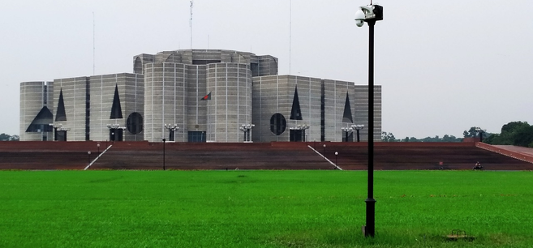
Recommendation
Immediate next steps
Adopt the university-funded baseline. Phase to approximately 130,000 participants per year. Treat 300,000 as a conditional Phase-4 question — not a starting commitment.
01
Constitute the inter-ministerial working group (Ministry of Education, UGC, Cabinet Division, Ministry of Public Administration, Ministry of Law)
02
Draft the primary legislation for the compulsory element; begin pilots under existing university autonomy
03
Issue the UGC budget-line circular giving public universities spending authority within existing grants
04
Sign MOUs with 10–15 pilot universities and 5 upazila host offices
05
Procure the national placement platform (BDT 500M–1,000M build-and-run, amortized at scale)
06
Commission the independent evaluation unit and appoint the program protection officer from day one
Gulshan Sync Solution · Porgona Bazar, Khadim Nagar, Sylhet, Bangladesh · Sultan Bayezid, Managing Director · bayezid@gulshansync.com
A public service citizens can see, measure, and trust — built one semester at a time.
Notes:
- Recommendation: adopt the university-funded baseline, phase to approximately 130,000 participants per year, and treat 300,000 only as a conditional Phase-4 question — not a starting commitment.
- Six immediate steps: inter-ministerial working group; draft primary legislation while pilots run under existing autonomy; UGC budget-line circular; MOUs with 10–15 universities and 5 upazilas; platform procurement (BDT 500M–1,000M); evaluation unit and protection officer from day one.
- Emphasize sequencing: the circular gives spending authority within existing grants — no new appropriation, no new fee.
- Close on the line: a public service citizens can see, measure, and trust — built one semester at a time.

